Slide 1
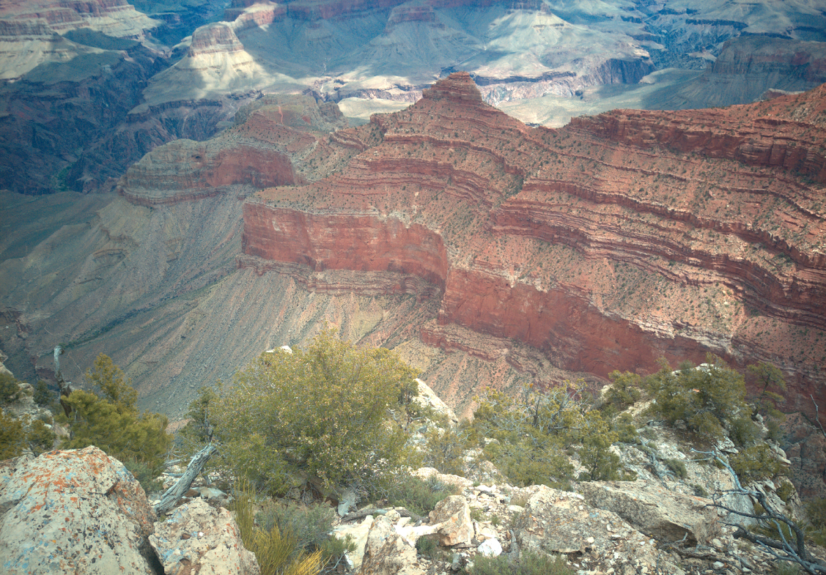
NINJA-SHOGUN Benjamin Hillmann Knights Lab

Slide 2
Transposon Collaboration
Goal
Visualize the results from a 2000 drug resistant transposon screen
Method
Create a radar plot
Center of the plot is PZA resistance
Distance from center is the frequency of TA sites hit for each gene
Size of node is proportional to the number of reads

Slide 3
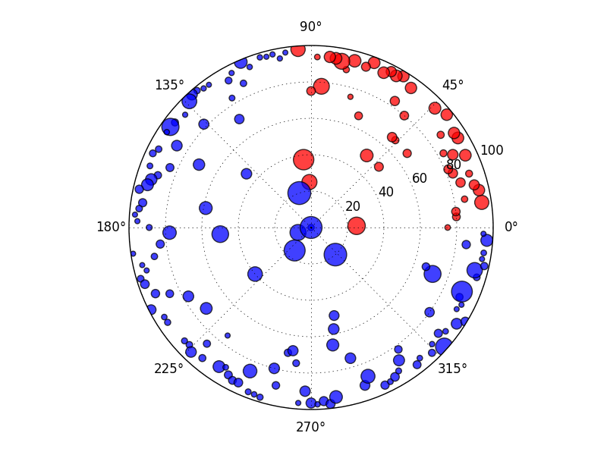
Creating a Bubble Graph
Blue = gene insertion
Red = intergenetic regions

Slide 4
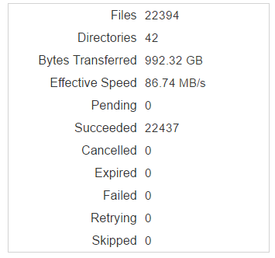
Globus
Created for research labs
Grid FTP with Web GUI
MSI is entirely set up with it

Slide 5
Chemotherapy and Dysbiosis
First patient has been recruited!
Samples are being collected and stored
Potential for working with blood samples

Slide 6

Anaconda
Conda
System and language agnostic package manager (R, Python, C)
Used by bioconda
Recipes
Configuration files for deploying and building packages
Lab repository
Anaconda website

Slide 7
Code Review: NINJA-OPS
BFG Repo-Cleaner
Making a conda-recipe
Installing on OSX/Linux

Slide 8

NINJA-DOJO
Annotate a database
Tree visualization in the future
Lazy load
NCBI Taxonomy
FTP links for RefSeq assemblies

Slide 9
NINJA-OPS: Installation
Install Miniconda
http://conda.pydata.org/miniconda.html
Make a new virtual environment
conda new –n ops pip
activate ops
Installl NINJA-OPS into virtual environment
conda install ninja_ops -c knights-lab/label/dev
Test the installation
ninja_ops.py -h

Slide 10
NINJA-SHOGUN: Installation
Make a new virtual environment
conda new –n shogun pip
activate shogun
Install shogun
conda install ninja_shogun -c knights-lab/label/dev
Test the installation

Slide 11
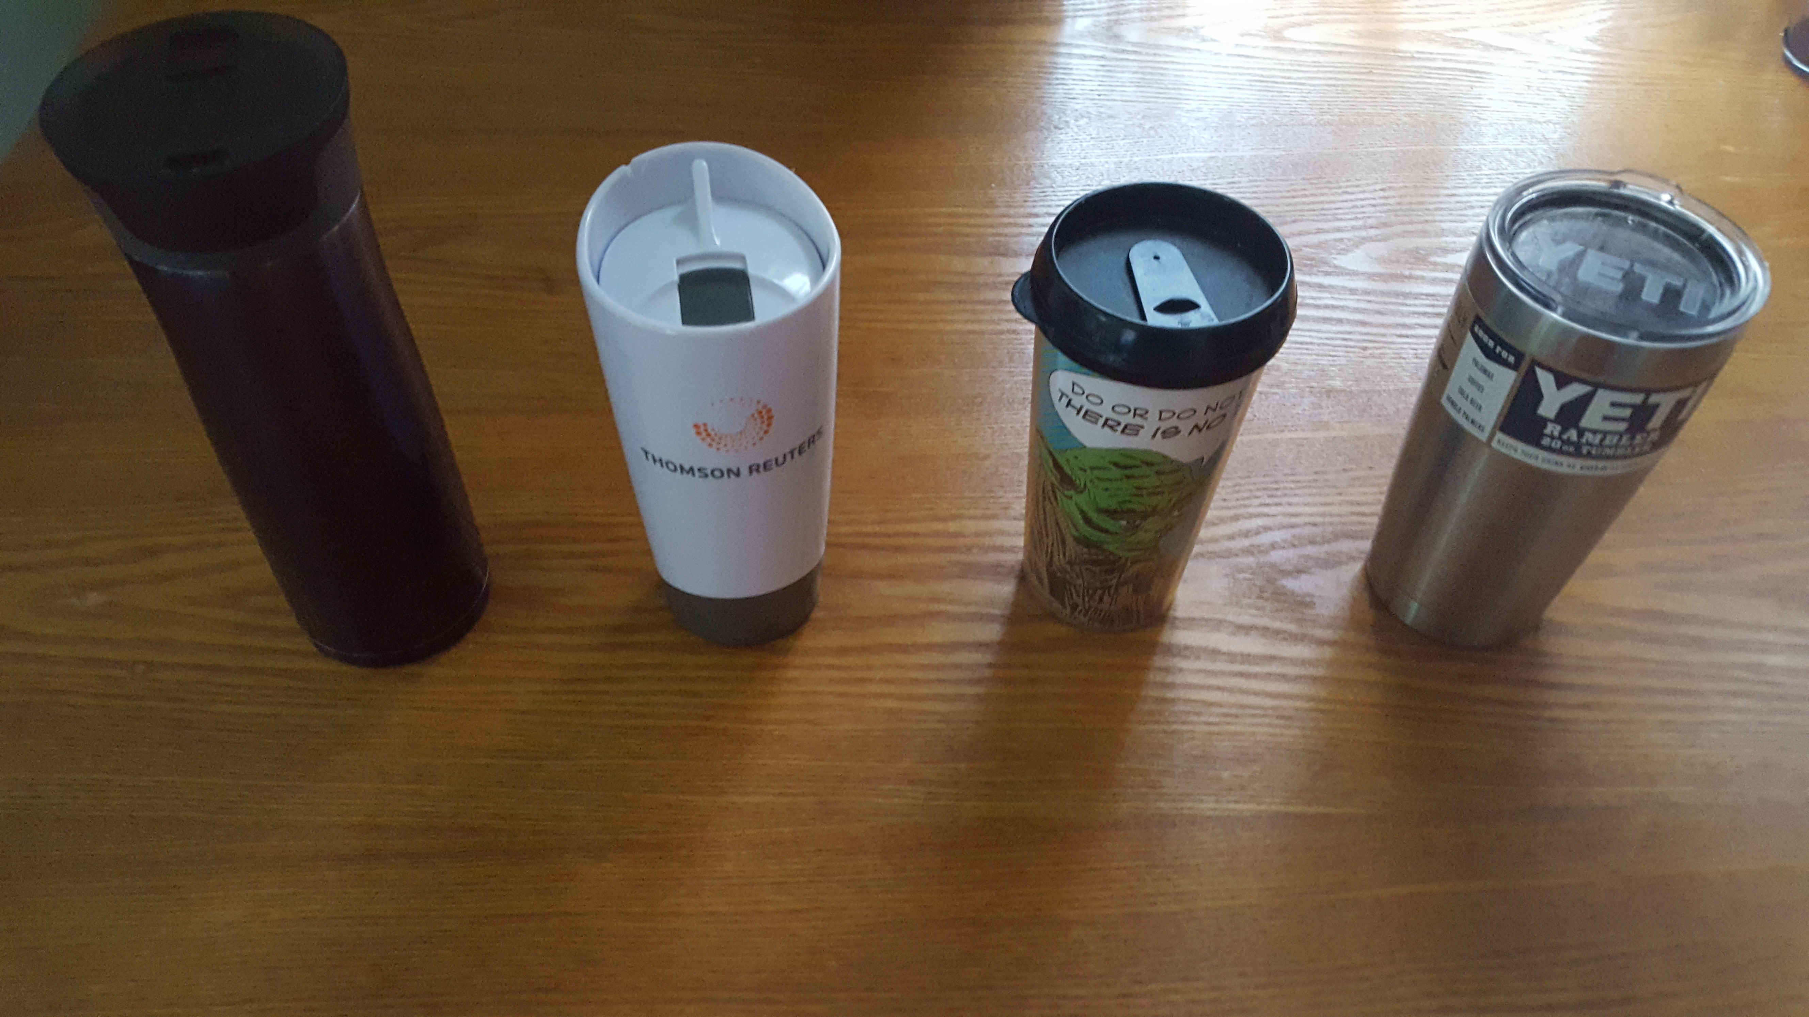
Cold as Science Allows

Slide 12
Results

Slide 13
NINJA-utils
Problem
Managing bioinformatic utility scripts across systems
We have a lot of custom executables that can be shared acrossed the lab (i.e. submit MSI job, linearize FASTA file, trimmomatic, time with memwatcher)
Solution
Add them to the conda recipe
conda install –c knights-lab ninja-trebuchet

Slide 14
NINJA-Database Of Justified Ontologies
Problem
Evaluate the accuracy of functional/taxonomic classifier
Build a common database
Goals
Unification of taxonomies
Automatic ‘lazy loading’ of databases
Specification of included taxonomies

Slide 15
SHallow shOtGUN profiler
Problem
16S amplicon sequencing has too many biases
Current shotgun sequencing techniques are not cost effective
Goals
Use > 5% of shotgun reads for species level assignment
Methods
Direct mapping of sequences to organisms
Use Last Common Ancestor for ambiguous mappings
Notes:
Need to read Shogun by James Clavelle

Slide 16
SHallow shOtGUN profiler
Short term goals
Focus on the validation of profilers
Build a ‘mock’ paper
Submit abstract to IHMC (June 30)
Build up RefSeq database
Map eggNOG orthologies to RefSeq
Notes:
Need to read Shogun by James Clavelle

Slide 17
Methods for Validation
Method Name | Class of Method | Sequence alignment method | Most recent year published (first time published) | Functional Classification | Number of citations | Website
Megan6 | Similarity | DIAMOND / NA | 2016 (2007) | KEGG, SEED, IterPro2GO, eggNOG | 1089* | http://ab.inf.uni-tuebingen.de/software/megan6/welcome/
Pathoscope | Similarity | Bowtie2 / NA | 2014 (2013) | NA | 58 | https://sourceforge.net/p/pathoscope/wiki/Home/
Metaphlan2 | Marker | Bowtie2 / NA | 2012 | NA | 311 | http://huttenhower.sph.harvard.edu/metaphlan2
PhyloPythiaS | Composition | NA / SVM | 2012 (2007) | NA | 269 | http://phylopythias.bifo.helmholtz-hzi.de/index.php?phase=wait
Kraken | Similarity | Exact match k-mers / NA | 2014 | NA | 158 | https://ccb.jhu.edu/software/kraken/
mOTU | Marker | HMMER3 / NA | 2013 | NA | 90 | http://www.bork.embl.de/software/mOTU/

Slide 18
Datasets for Validation
IBD Study
Test if shallow approach can distinguish disease state
HMP Mock Community
A in vitro community
Simulated Human Metagenome from RefSeq
MetaPhlan2 ‘gold’ simulated datasets
Test for database bias

Slide 19
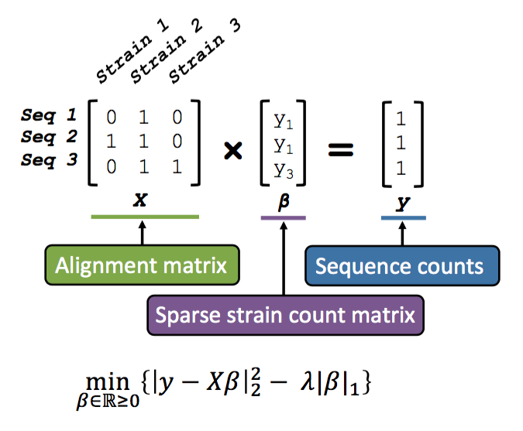
Taxonomic Assignment

Slide 20
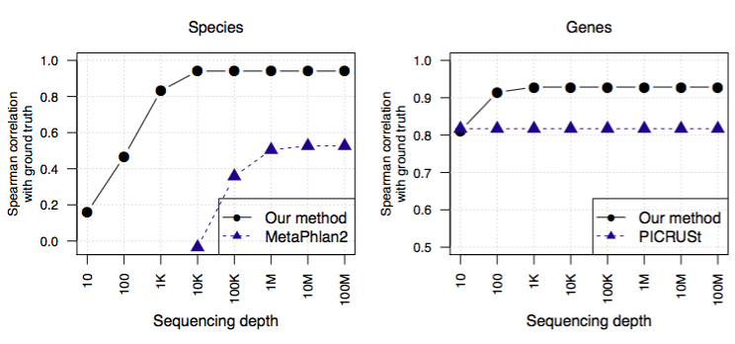
Profiling

Slide 21
NINJA-SHOGUN
Summary
General purpose library for translating sequence accession to taxonomy
Precise taxonomic and functional profiling of
Future Work
Needs a faster, more memory efficient LCA tree
20 second load
Controlling for false positives

